Slide 1
New developments in the Radiotherapy of Prostate Cancer High Precision in Short time
Dr. David Kuczer – Radiation Oncologist

Slide 2
PART 1 Role of Radiotherapy now
Dr. David Kuczer – Radiation Oncologist

Slide 3
Why patients ask for Radiotherapy
Patients are looking for an alternative to Operation because…
Afraid of operation
Want an alternative treatment that offers the same tumor control
Do not want to wear a diaper
Want to keep their sexual life
Dr. David Kuczer – Radiation Oncologist

Slide 4
Why patients ask for Radiotherapy
Want an alternative treatment that offers the same tumor control
Do not want to wear a diaper
Want to keep their sexual life
..But can Radiotherapy offer this alternative ?
Dr. David Kuczer – Radiation Oncologist

Slide 5
Why patients ask for Radiotherapy
Want an alternative treatment that offers the same tumor control
Do not want to wear a diaper
Want to keep their sexual life
..But can Radiotherapy offer this alternative ?
YES WE CAN
Dr. David Kuczer – Radiation Oncologist

Slide 6
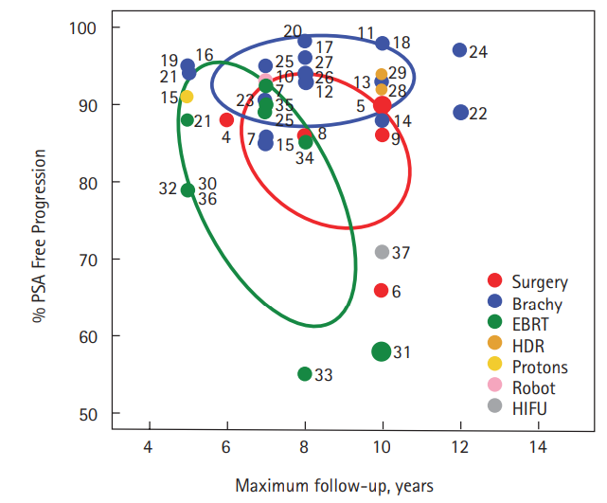
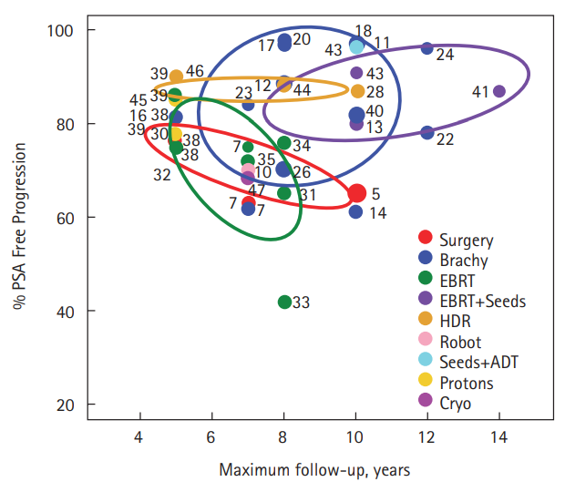
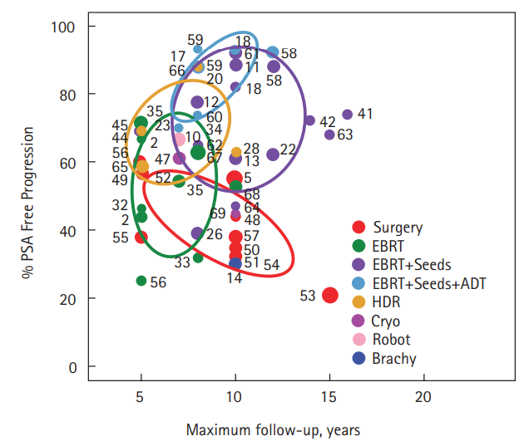
Comparing Radiotherapy and Operation OP
Tumor control rate RT
Low risk Intermediate risk High risk
Best outcome: of 52.000 patients and 7 methods
Brachytherapy EBRT+Brachytherapy EBRT+Brachytherapy+ADT
Grimm P, et al. Comparative analysis of prostate-specific antigen free survival outcomes for patients with low, intermediate and high risk prostate cancer treatment by radical therapy. Results from the Prostate Cancer
Results Study Group. BJU Int. 2012 Feb;109
Suppl 1:22-9. doi: 10.1111/j.1464-410X.2011.10827.x. PMID: 22239226.
Dr. David Kuczer – Radiation Oncologist

Slide 7
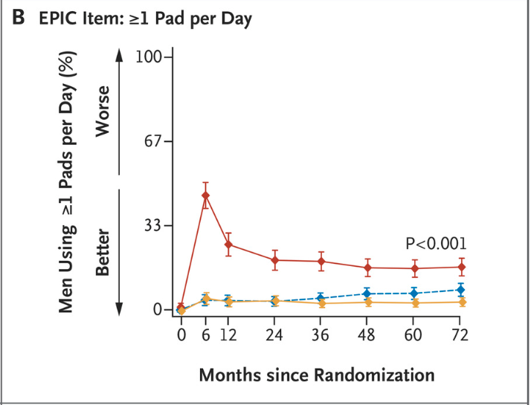
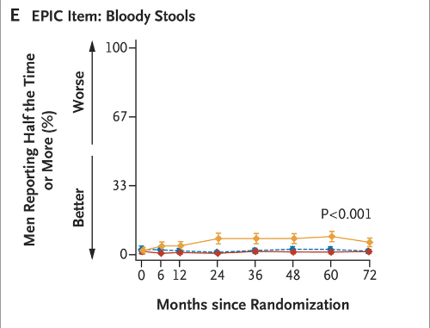
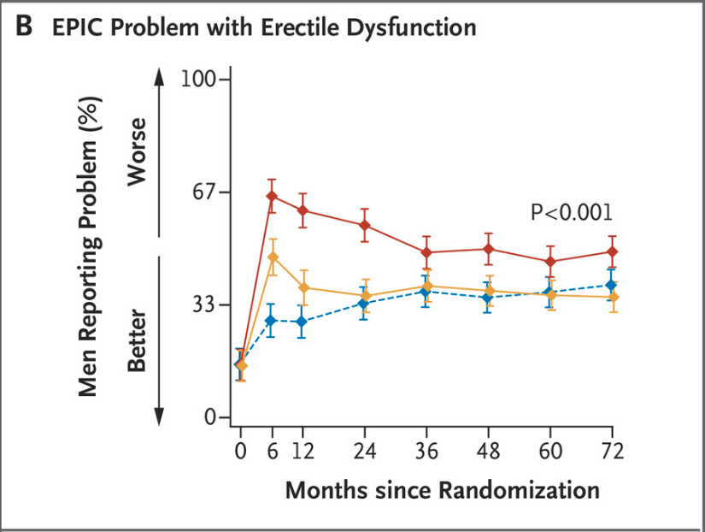
Comparing Radiotherapy and Operation
Treatment tolerance and side Effects
ProtecT
P
ProtecT Trial NEJM 1643 patients
Side Effect | Watch | RT | OP
Permanent Urinary Incontinence | 8% | 4% | 17%
Baseline sexual activity | 67% | 67% | 67%
Sexual active after 6 years | 30% | 27% | 17%
Bloody stool | - | 1-3% | -
Therapy related letality | 0 | 0 | 0,48%*
Risk of secondary cancer | 0 | 0,5%+ | 0
*Shabbir M. et al., 30-Day Mortality and Major Complications after Radical Prostatectomy: Influence of Age and Comorbidity, JNCI: Journal of the National Cancer Institute, Volume 97, Issue 20, 19 October 2005, Pages 1525–1532,.
+ https://med.stanford.edu/news/all-news/2022/070/prostate-radiation-slightly-increases-the-risk-of-developing-ano.html*
Donovan JL, et al.; ProtecT Study Group*. Patient-Reported Outcomes after Monitoring,
Surgery, or Radiotherapy for Prostate Cancer. N Engl J Med. 2016 Oct 13;375(15):1425-1437. doi: 10.1056/NEJMoa1606221. Epub 2016 Sep 14. Erratum in: N Engl J Med. 2023 Jun 8;388(23):2208.
PMID: 27626365; PMCID: PMC5134995.
Dr. David Kuczer – Radiation Oncologist

Slide 8
PART 2 New developments
Dr. David Kuczer – Radiation Oncologist

Slide 9
Why patients avoid Radiotherapy
Do not want to travel 39 times to the clinic over a period of 2 months
..But can modern Radiotherapy offer an alternative ?
Dr. David Kuczer – Radiation Oncologist

Slide 10
Why patients avoid Radiotherapy
Do not want to travel 39 times to the clinic over a period of 2 months
..But can modern Radiotherapy offer an alternative ?
YES WE CAN
Dr. David Kuczer – Radiation Oncologist

Slide 11
Introducing
Linac based stereotactic Radiotherapy of localized Prostate Cancer
Reducing treatment time from 2 Months to 2 Weeks
Dr. David Kuczer – Radiation Oncologist

Slide 12
5 year outcome of the Hypo RT PC Trial
Multicentric prospective randomized Phase 3 Study (Sweden , Denmark)
1200 patients with localized intermediate and high risk Prostate cancer
Arm A 39 x 2,0 Gy
Arm B 7 x 6,1 Gy (biologically iso – effective)
Widmark A, et al.Ultra-hypofractionated versus conventionally fractionated
radiotherapy for prostate cancer: 5-year outcomes of the HYPO-RT-PC
randomised, non-inferiority, phase 3 trial. Lancet.
2019 Aug 3;394(10196):385-395. doi: 10.1016/S0140-6736(19)31131-6.
Epub 2019 Jun 18. PMID: 31227373.
Dr. David Kuczer – Radiation Oncologist

Slide 13
5 year outcome of the Hypo RT PC Trial
5 year PFS 84%
Side effects during treatment time:
Reversible Grade II Pollakisuria at the end of therapy: 23 vs 28% (lasts 2-3 weeks)
Late side effects:
No difference to conventional Radiotherapy (p 5% Urinary toxicity, p aprox. 3% bowel toxicity)
Widmark A, et al.Ultra-hypofractionated versus conventionally fractionated
radiotherapy for prostate cancer: 5-year outcomes of the HYPO-RT-PC
randomised, non-inferiority, phase 3 trial. Lancet.
2019 Aug 3;394(10196):385-395. doi: 10.1016/S0140-6736(19)31131-6.
Epub 2019 Jun 18. PMID: 31227373.
Dr. David Kuczer – Radiation Oncologist

Slide 14
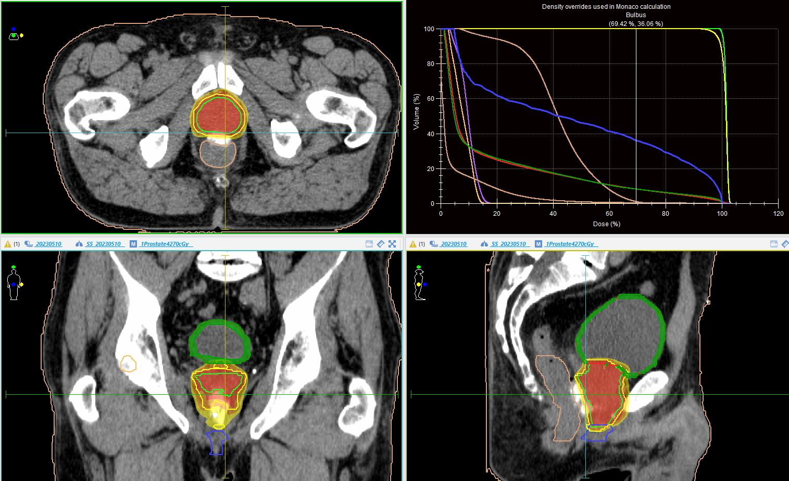
Dr. David Kuczer – Radiation Oncologist

Slide 15
Thank You!
Dr. David Kuczer – Radiation Oncologist

